Slide 1
RDBMS Présentation
Relational database management system

Slide 2
Summary :
What is RDBMS ?
MYSQL definition and functionalities
PostegreSQL definition and functionalities
SQL SERVER definition and functionalities
Comparison betwenn the three of them

Slide 3
What is RDBMS ?
An RDBMS, or relational database management system, is the software that gives users the ability to update, query and administer a relational database. Structured Query Language (SQL) is typically the standard programming language used to access the database.

Slide 4
MYSQL definition and functionalities
MySQL is free and open-source software under the terms of the GNU General Public License, and is also available under a variety of proprietary licenses. MySQL was owned and sponsored by the Swedish company MySQL AB, which was bought by Sun Microsystems (now Oracle Corporation).In 2010, when Oracle acquired Sun, Widenius forked the open-source MySQL project to create MariaDB.
The application is used for a wide range of purposes, including data warehousing, e-commerce, and logging applications.

Slide 5
PostegreSQL definition and functionalities
PostgreSQL is an advanced, enterprise-class, and open-source relational database system. PostgreSQL supports both SQL (relational) and JSON (non-relational) querying.
PostgreSQL is a highly stable database backed by more than 20 years of development by the open-source community.
PostgreSQL is used as a primary database for many web applications as well as mobile and analytics applications.
Many companies have built products and solutions based on PostgreSQL. Some featured companies are Apple, Fujitsu, Red Hat, Cisco, Juniper Network, Instagram, etc.

Slide 6
SQL SERVER definition and functionalities
SQL Server is a relational database management system, or RDBMS, developed and marketed by Microsoft.
Similar to other RDBMS software, SQL Server is built on top of SQL, a standard programming language for interacting with the relational databases. SQL server is tied to Transact-SQL, or T-SQL, the Microsoft’s implementation of SQL that adds a set of proprietary programming constructs.
SQL Server works exclusively on Windows environment for more than 20 years. In 2016, Microsoft made it available on Linux. SQL Server 2017 became generally available in October 2016 that ran on both Windows and Linux.

Slide 7
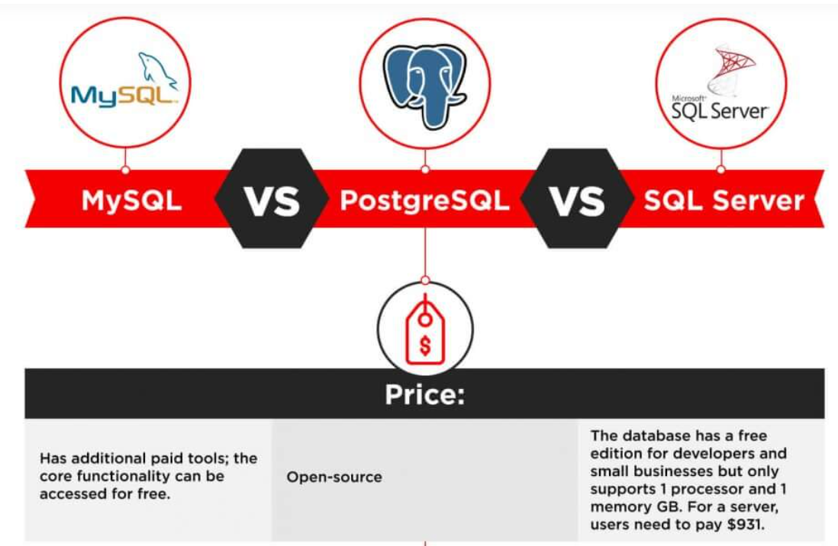
Comparison betwenn the three of them
In this comparison, we’ll take a look at the functionality of the three most popular SQL databases, examine their use cases, respective advantages, and disadvantages. Firstly, we’ll start by exploring the in-depth functionality.

Slide 8
Defragmentation :
Temporary Tables :
MySQL offers several approaches to defragmentation – during backup, index creation, and with an OPTIMIZE Table command. Without going into much detail, we’ll just say that having that many options for table maintenance is convenient for developers, and it surely saves a lot of time.
PostgreSQL allows scanning the entire tables of a data layer to find empty rows and delete the unnecessary elements. By doing so, the system frees up the disk space. However, the method requires a lot of CPU and can affect the application’s performance.
SQL Server offers an efficient garbage collector that doesn’t create more than 15-20% of overhead. Technically, developers can even run garbage collector on a continuous basis, because it’s that efficient.
MySQL offers limited functionality for temporary tables. Developers cannot set variables or create global templates. The software even limits the number of times that a temporary table can be referred to – not more than once.
Postgresql offers a lot more functionality when it comes to temporary content. You divide temporary tables into local and global and configure them with flexible variables.
SQL Server also offers rich functionality for temporary table management. You can create local and global temporary tables, as well as oversee and create variables.

Slide 9
Indexes :
Memory-Optimized Tables :
MySQL organized indexes in tables and clusters. Developers can automatically locate and update indexes in their databases. The search isn’t highly flexible – you can’t search for multiple indexes in a single query. MySQL supports multi-column indexes, allowing adding up to 16 columns.
PostgreSQL also supports index-based table organization, but the early versions don’t include automated index updates (which appear only after the 11th edition release). The solution also allows looking up many indexes in a single search, which means that you can find a lot of information. The multi-column settings are also more flexible than in MySQL – developers can include up to 32 columns.
SQL Server offers rich automated functionality for index management. They can organize in clusters and maintain the correct row order without manual involvement. The solution also supports multiple-index searches and partial indexes.
MySQL supports the memory-stored table, but it can’t participate in transactions, and its security is highly vulnerable. Such tables are used only for reading purposes and can simplify exclusively primitive operations. For now, MySQL doesn’t come close to making the most out of memory-optimized tables.
PostgreSQL doesn’t support in-memory database creation.
SQL Server uses an optimistic strategy to handle memory-optimized tables, which means they can participate in transactions along with ordinary tables. Memory-based transactions are faster than regular ones, and this allows a drastic increase in application speed.

Slide 10
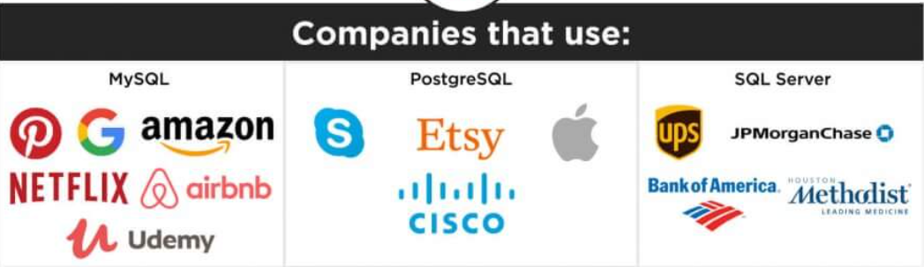

Slide 11
Thanks For Your Attention ☺

